Slide 1


TicketIQ
A Centralized IT Service Management (ITSM) Prototype

Slide 2
Introduction
Our TicketIQ platform is a prototype that seamlessly integrates centralized support tracking with a structured, professional workflow. Imagine an IT environment where requests no longer get lost in email chains or verbal conversations, but are instantly logged and tracked in real-time.
This system ensures that issue resolution is accelerated, accountability is enforced, and operational efficiency is maximized. It's not just a ticketing system it is an optimized and a smarter way to manage your organization's IT infrastructure.

Slide 3
Description
Our system streamlines IT support by enabling users to submit Change Requests through a unified portal. Instead of getting lost in emails, these requests enter a structured pipeline where managers review them via a Pending Requests dashboard. Only approved requests become actionable Incidents, ensuring technical teams focus on vetted issues.
With Role-Based Access Control (RBAC), TicketIQ provides personalized dashboards for every user type. Managers can monitor team performance through real-time analytics and dynamic charts.
This centralized approach ensures that IT operations are accountable, data-driven, and significantly more efficient than traditional methods.

Slide 4
Web Page Layout
Landing and Login

Slide 5
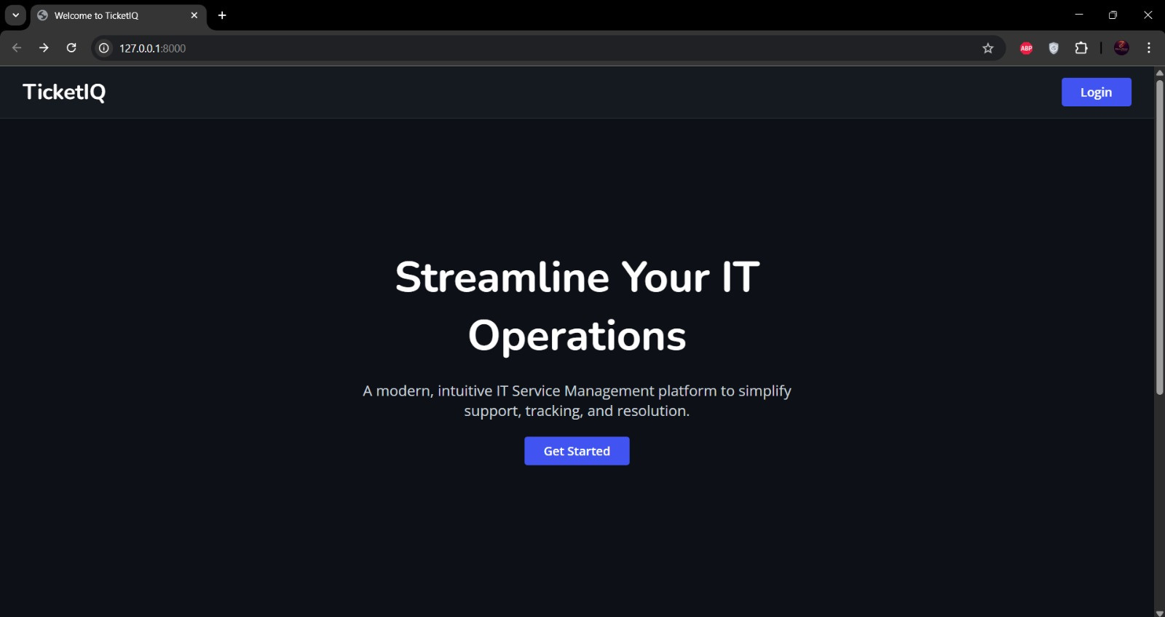

Slide 6
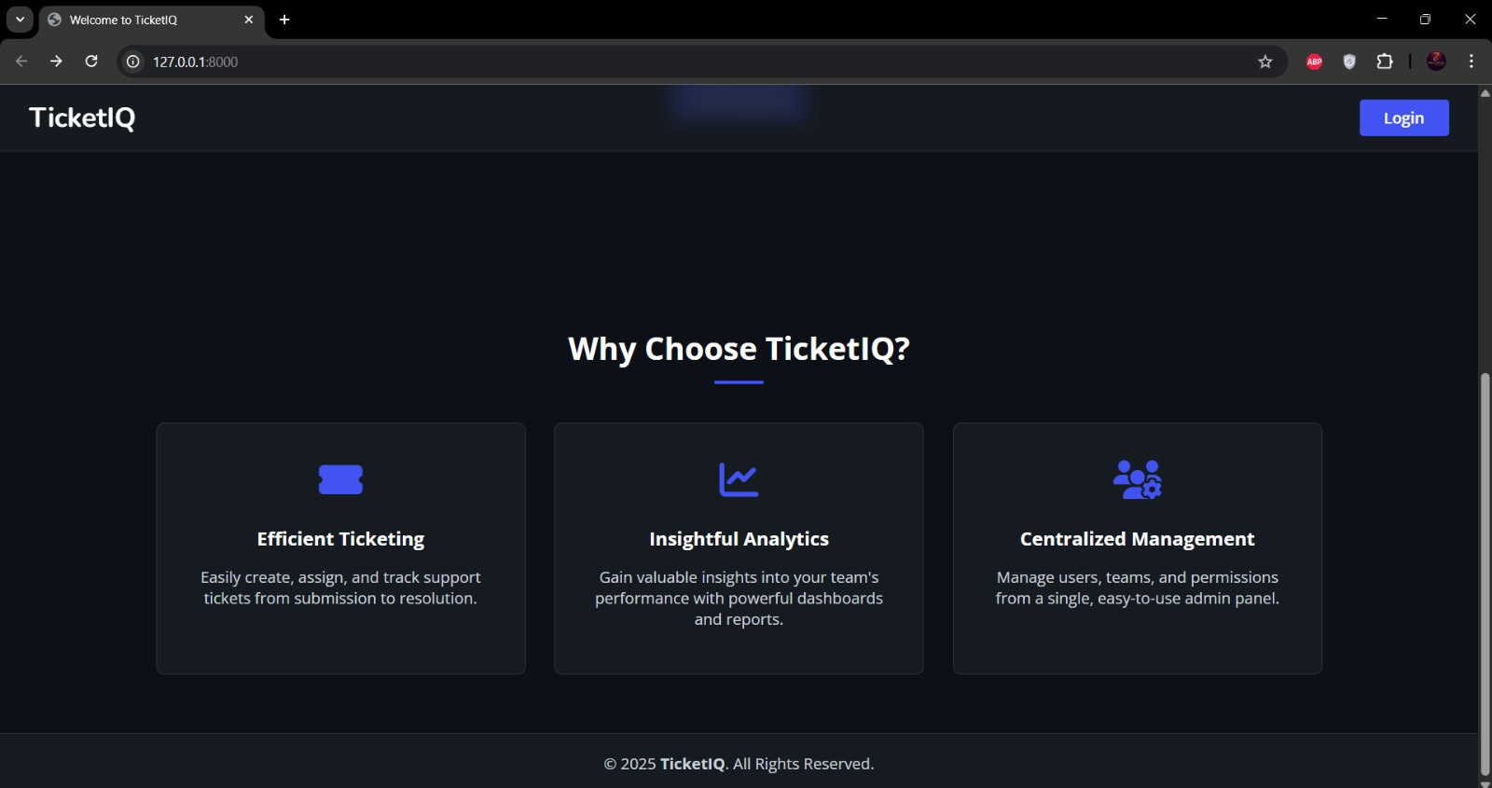

Slide 7
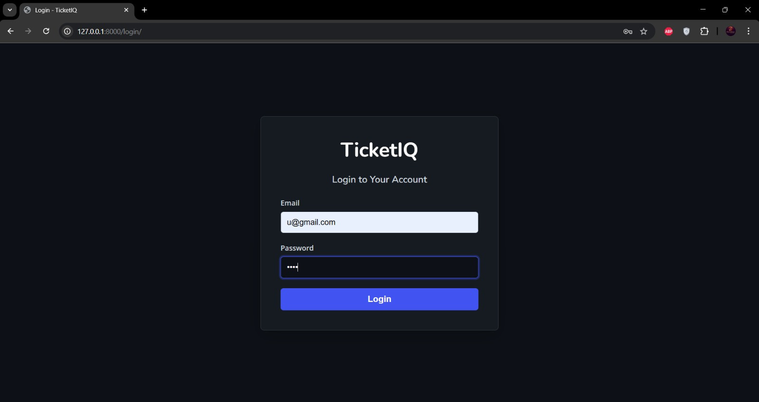

Slide 8
Web Page Layout
Admin Side

Slide 9
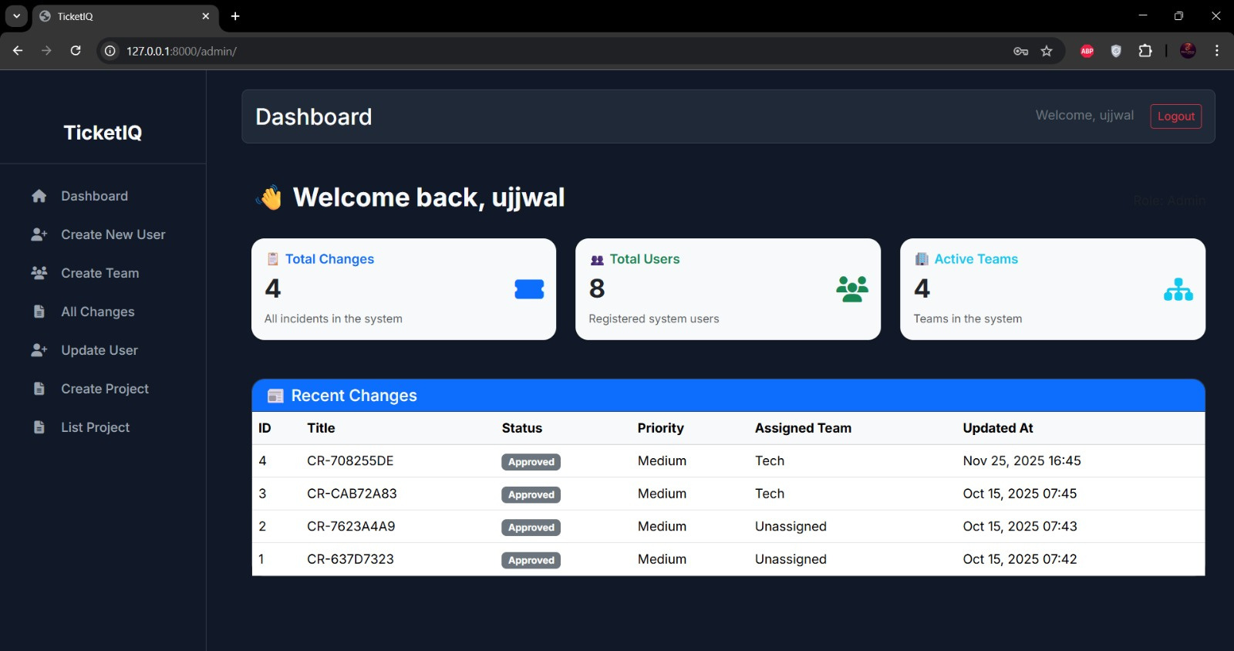
Dashboard

Slide 10
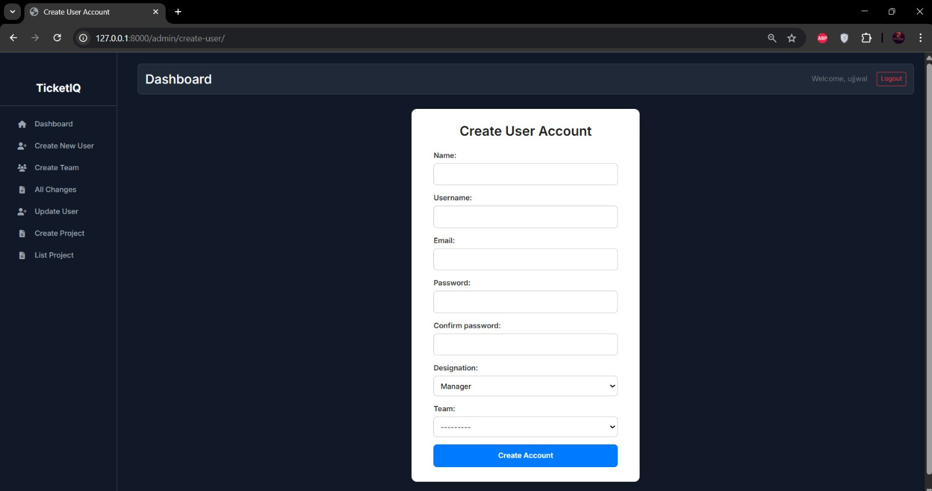
Create New User Page

Slide 11
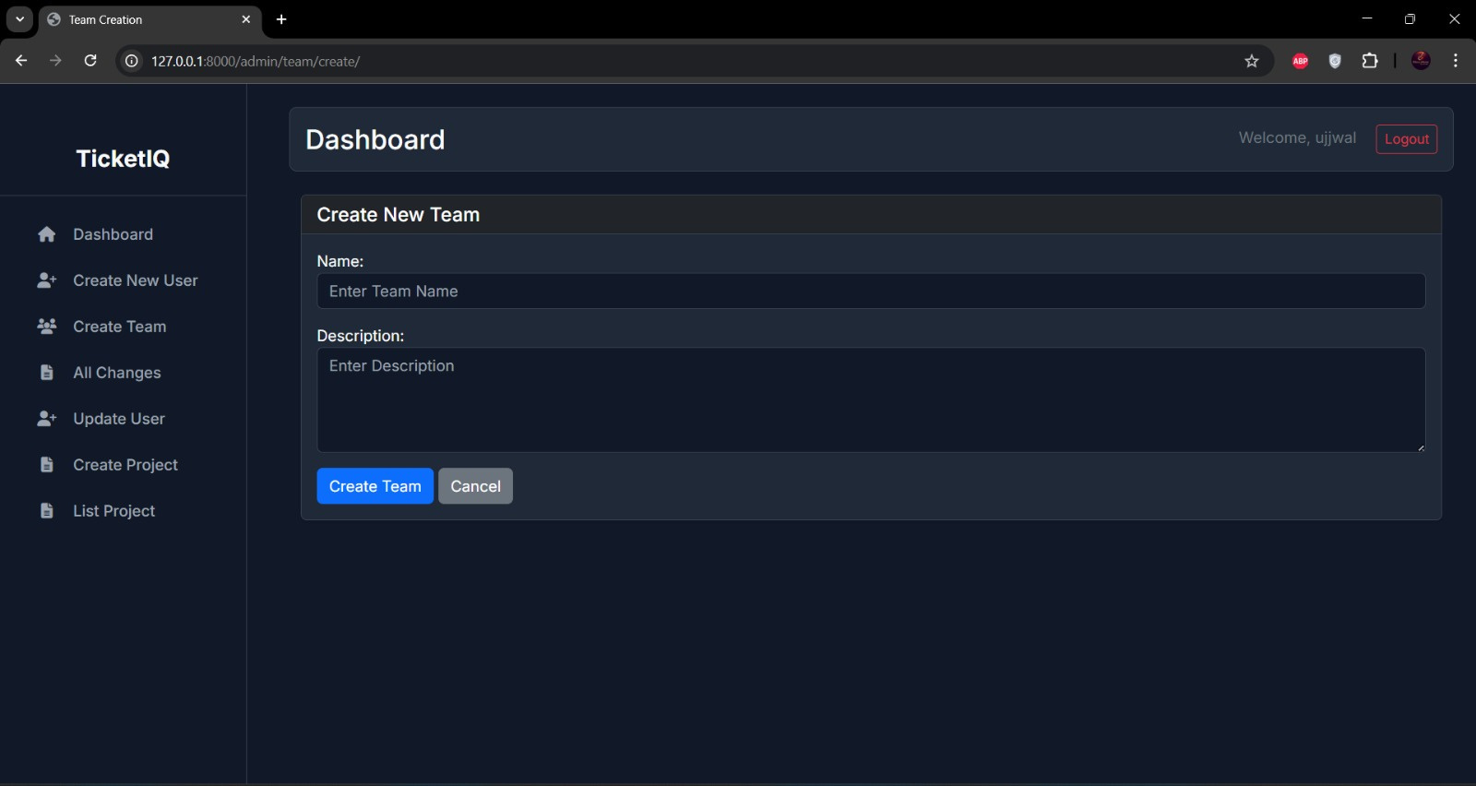
Create Team Page

Slide 12
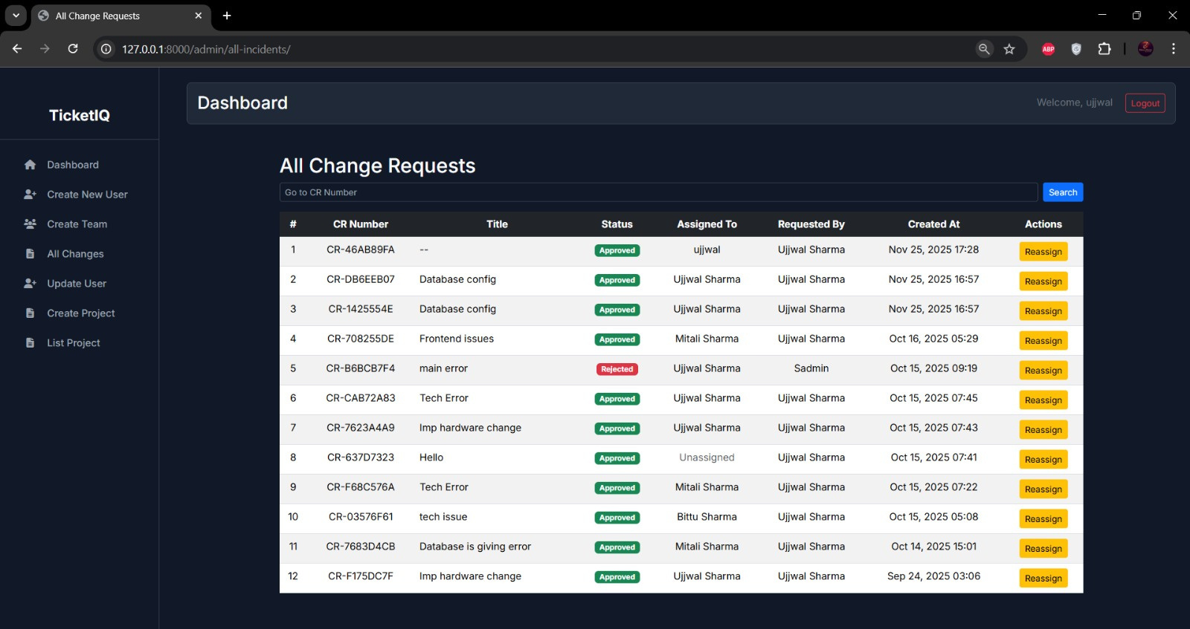
All Incidents Page

Slide 13
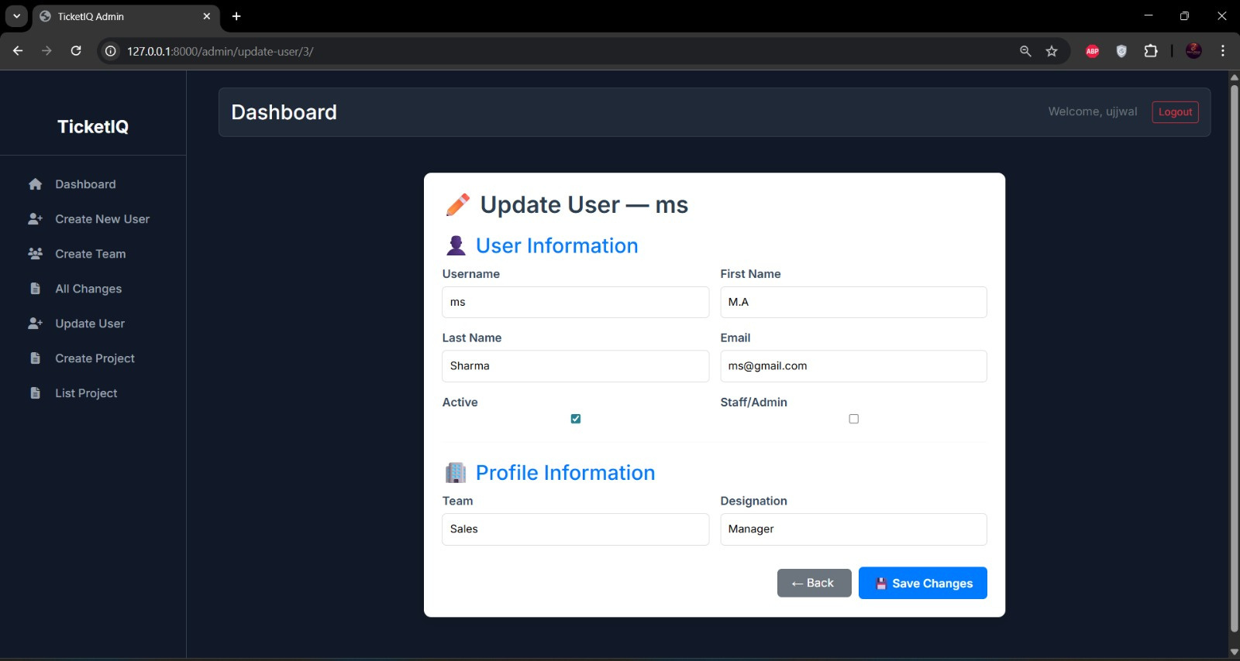
Update User Page

Slide 14
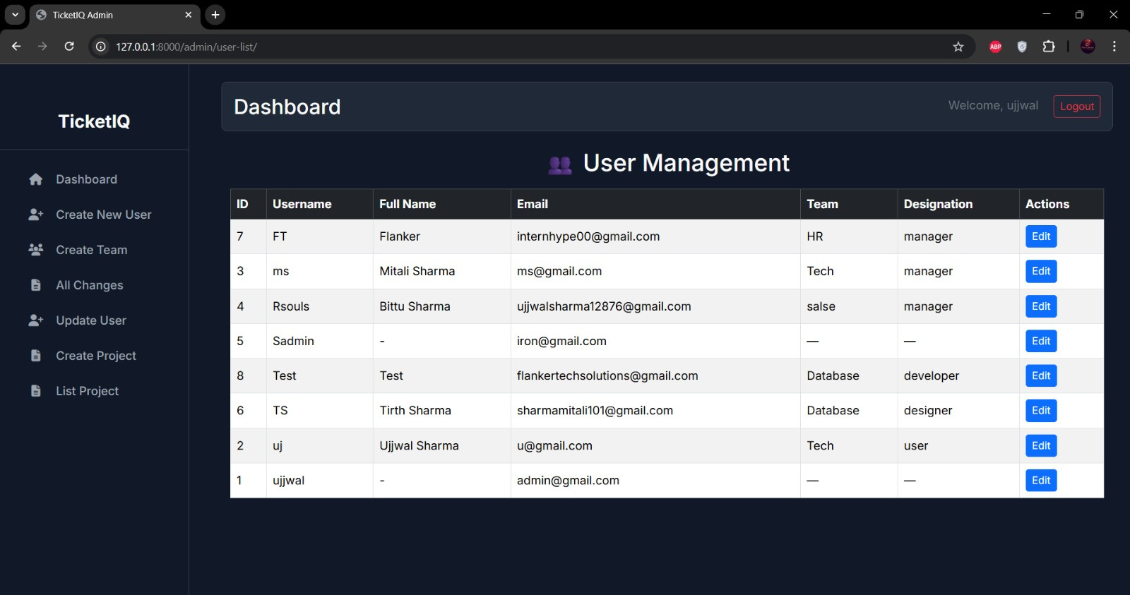

Slide 15
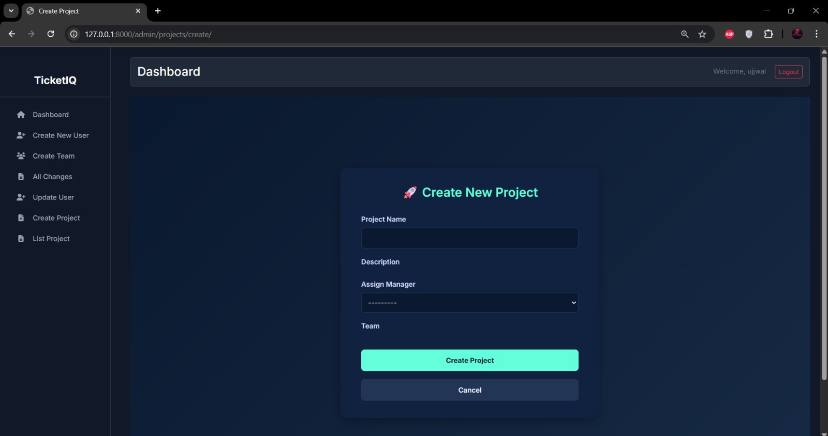
Create New Project

Slide 16
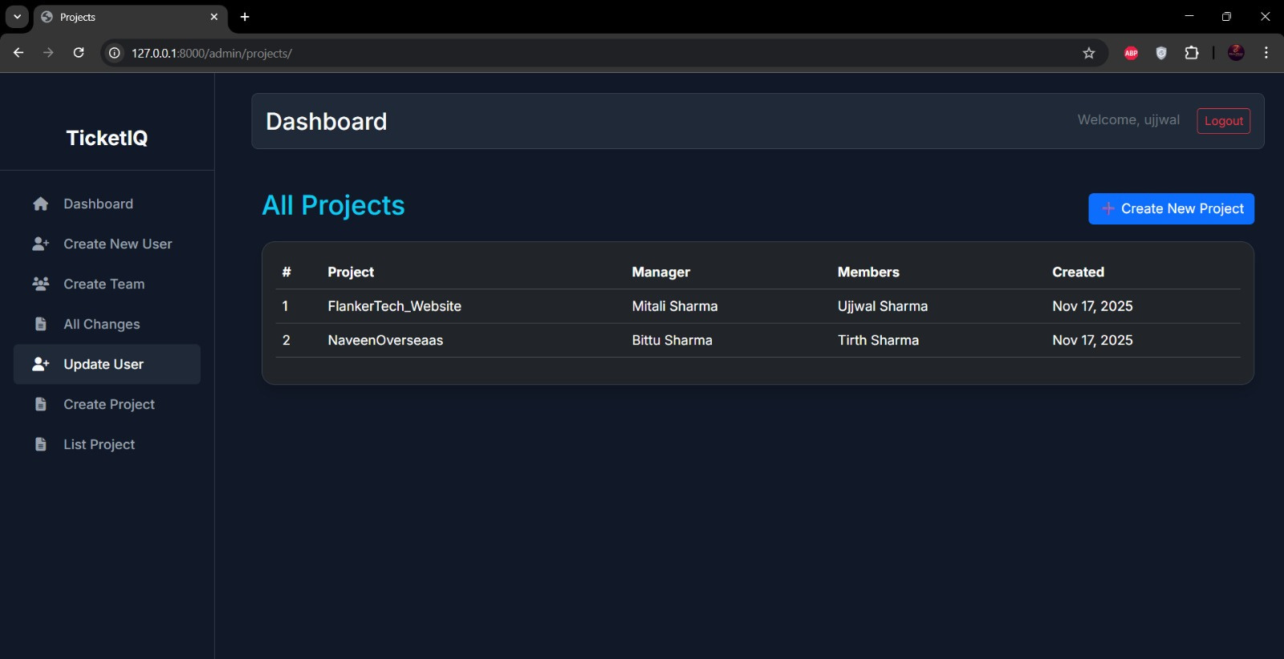
View All Project

Slide 17
Web Page Layout
Manager Side

Slide 18
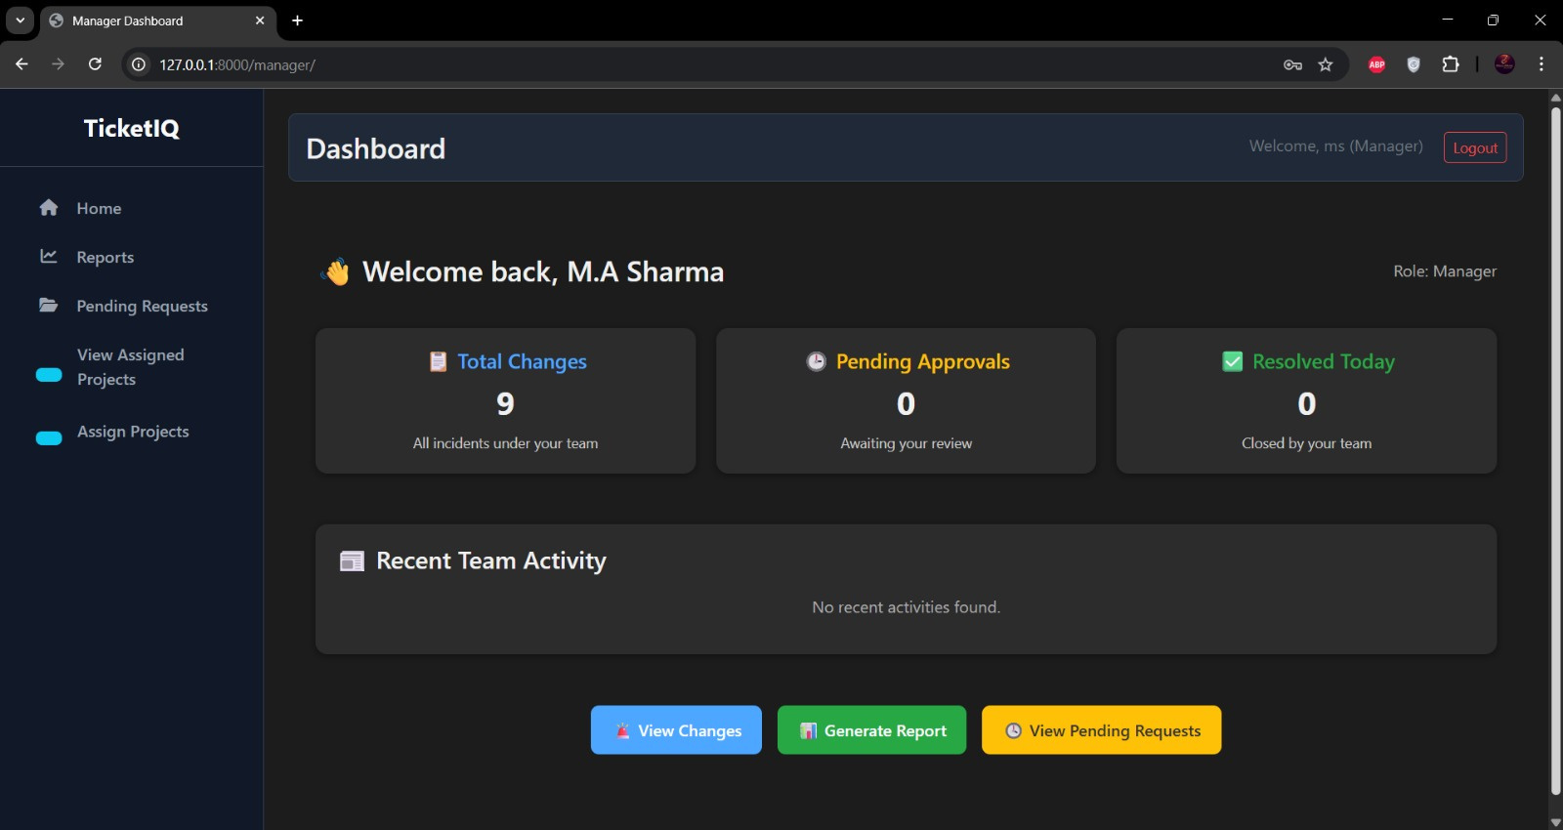
Dashboard

Slide 19
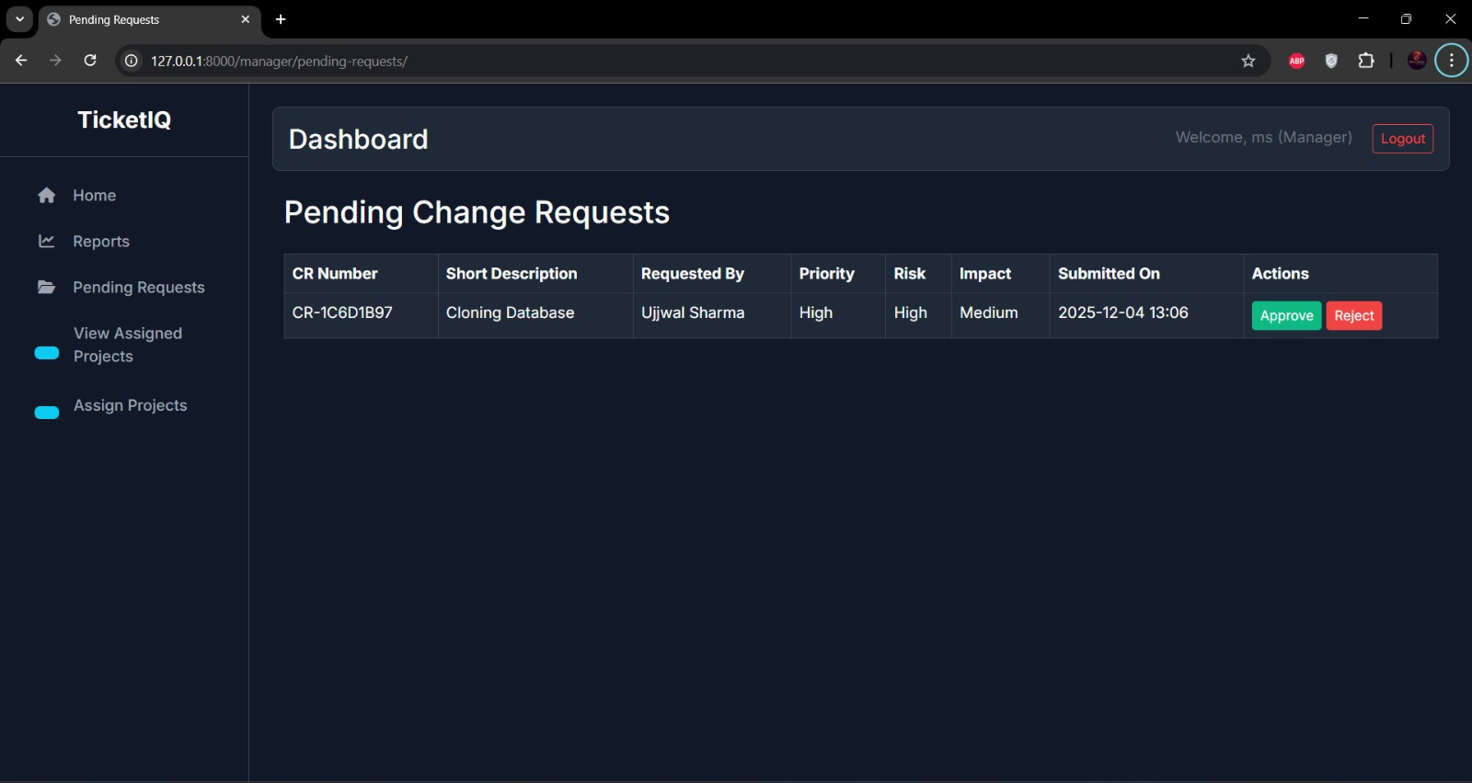
Pending Requests Page

Slide 20
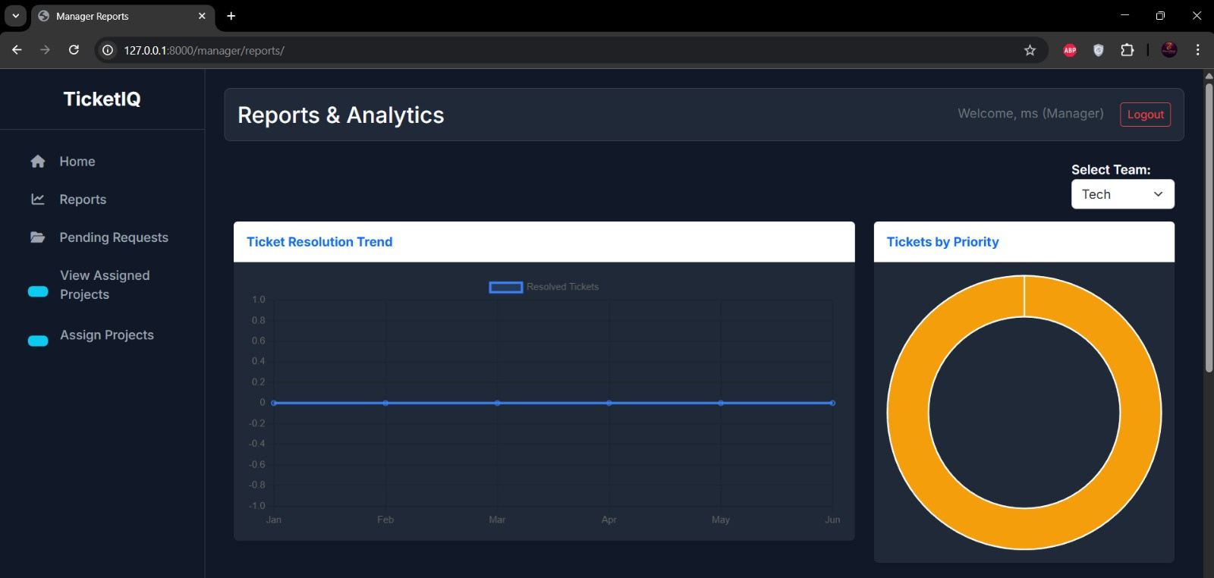
Reports Page

Slide 21
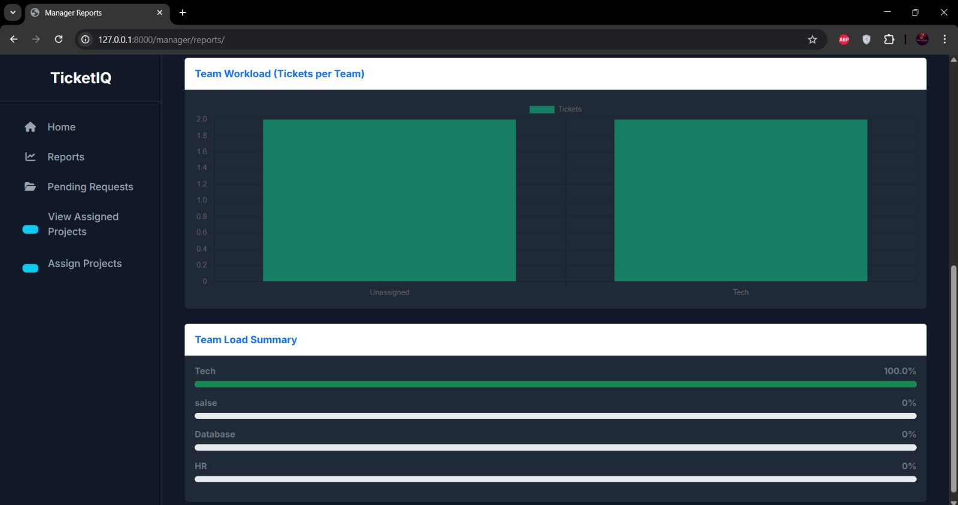

Slide 22
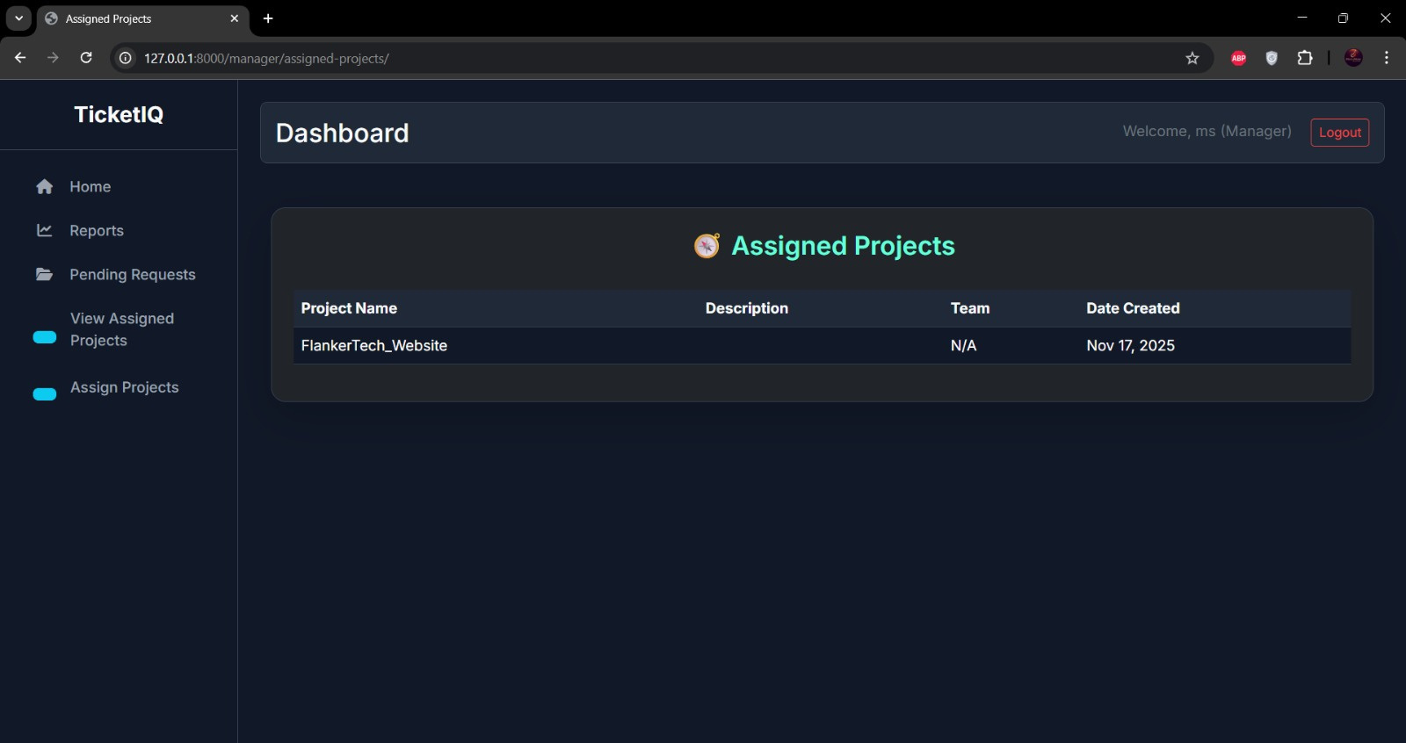
Assigned Projects

Slide 23
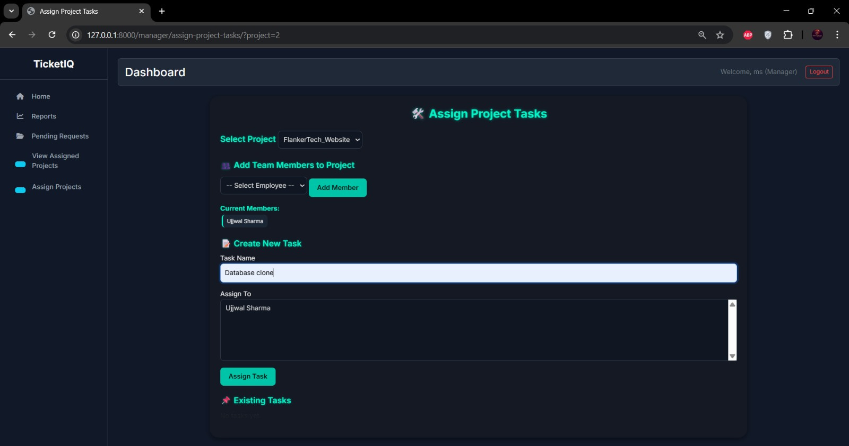
Assign Project Tasks

Slide 24
Web Page Layout
User Side

Slide 25
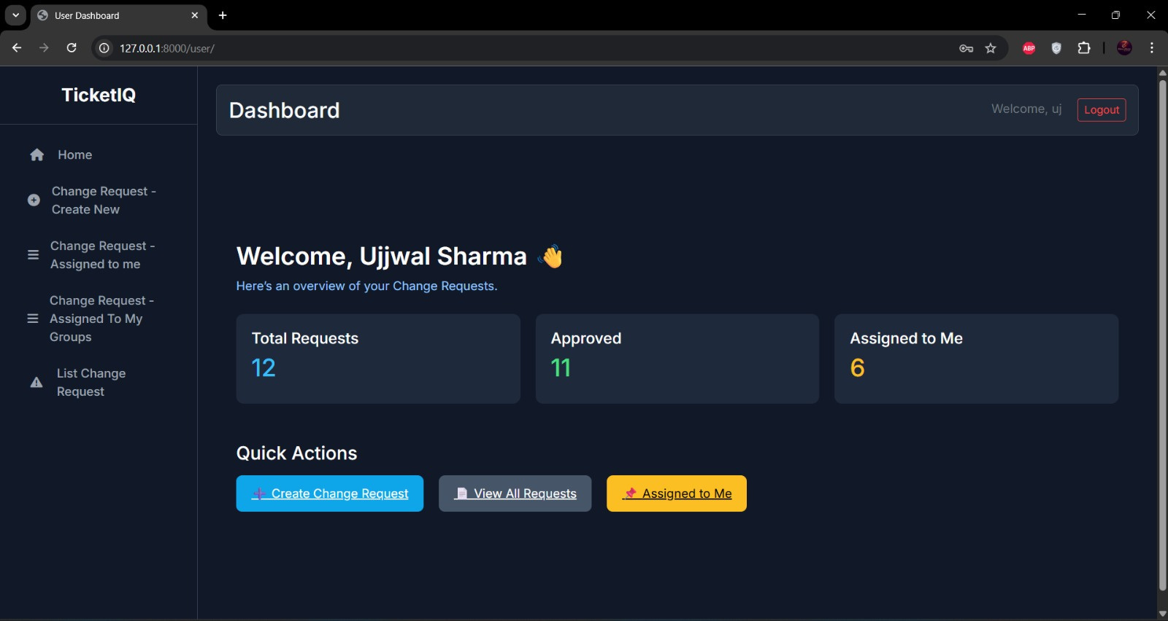
Dashboard

Slide 26
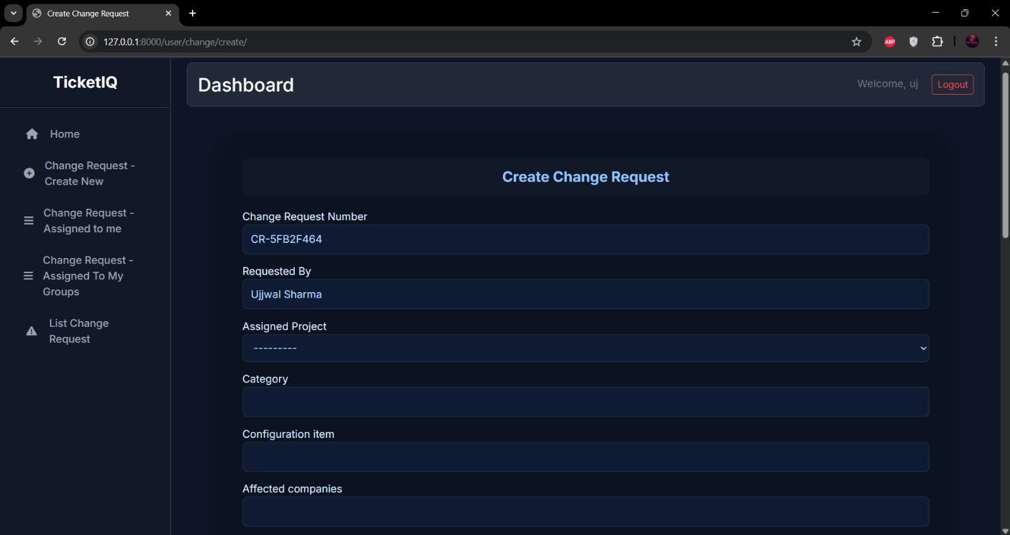
Create Change Requests Form

Slide 27
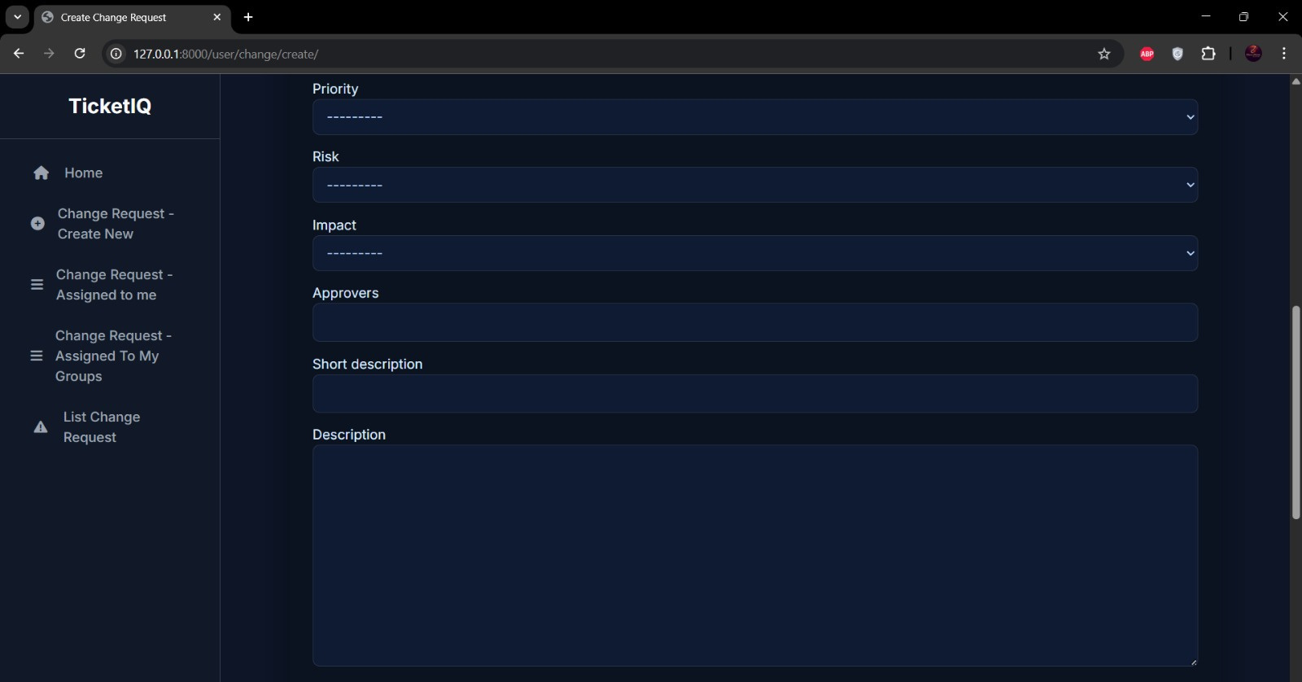

Slide 28
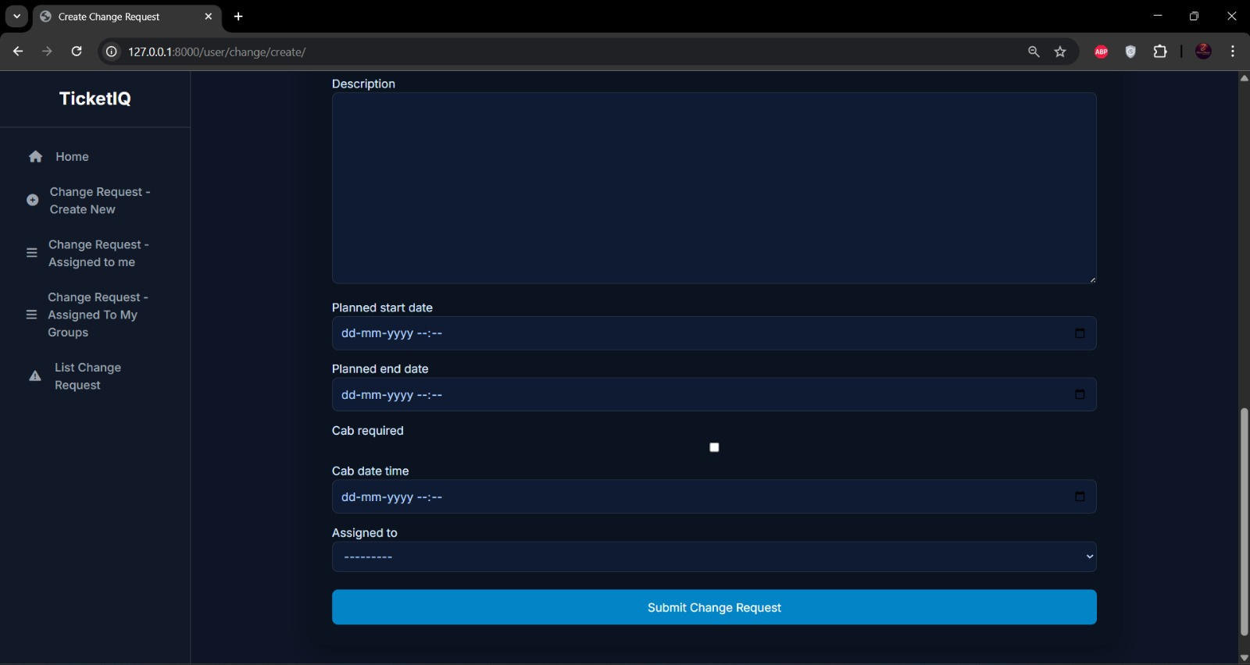

Slide 29
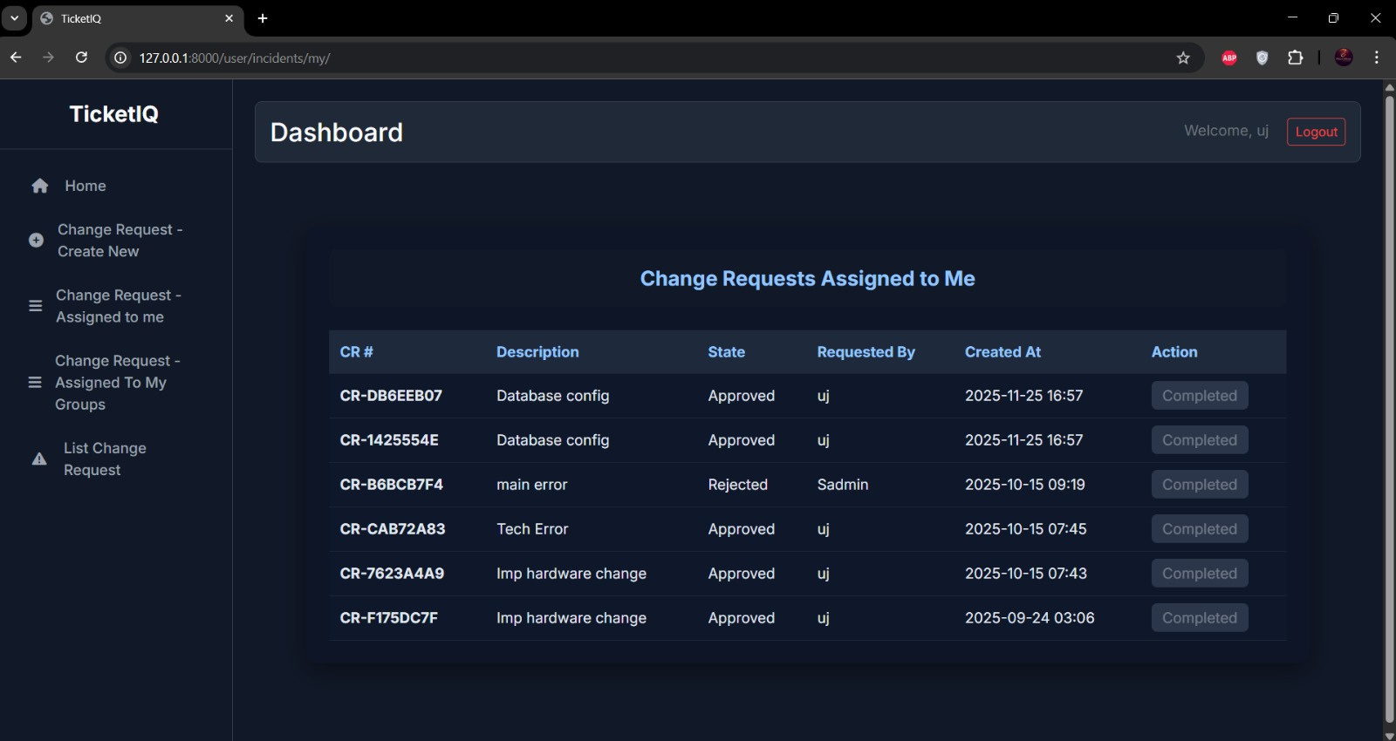
“Assigned to Me” Page

Slide 30
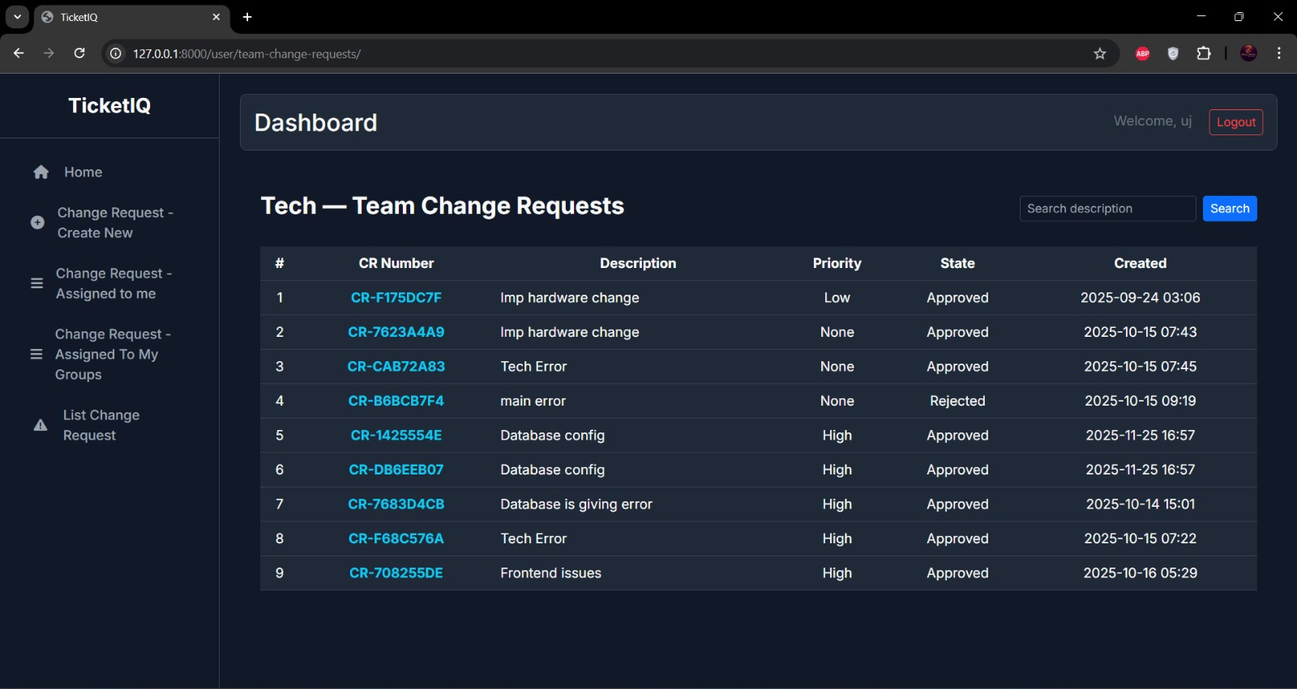
Team Change Requests Page

Slide 31
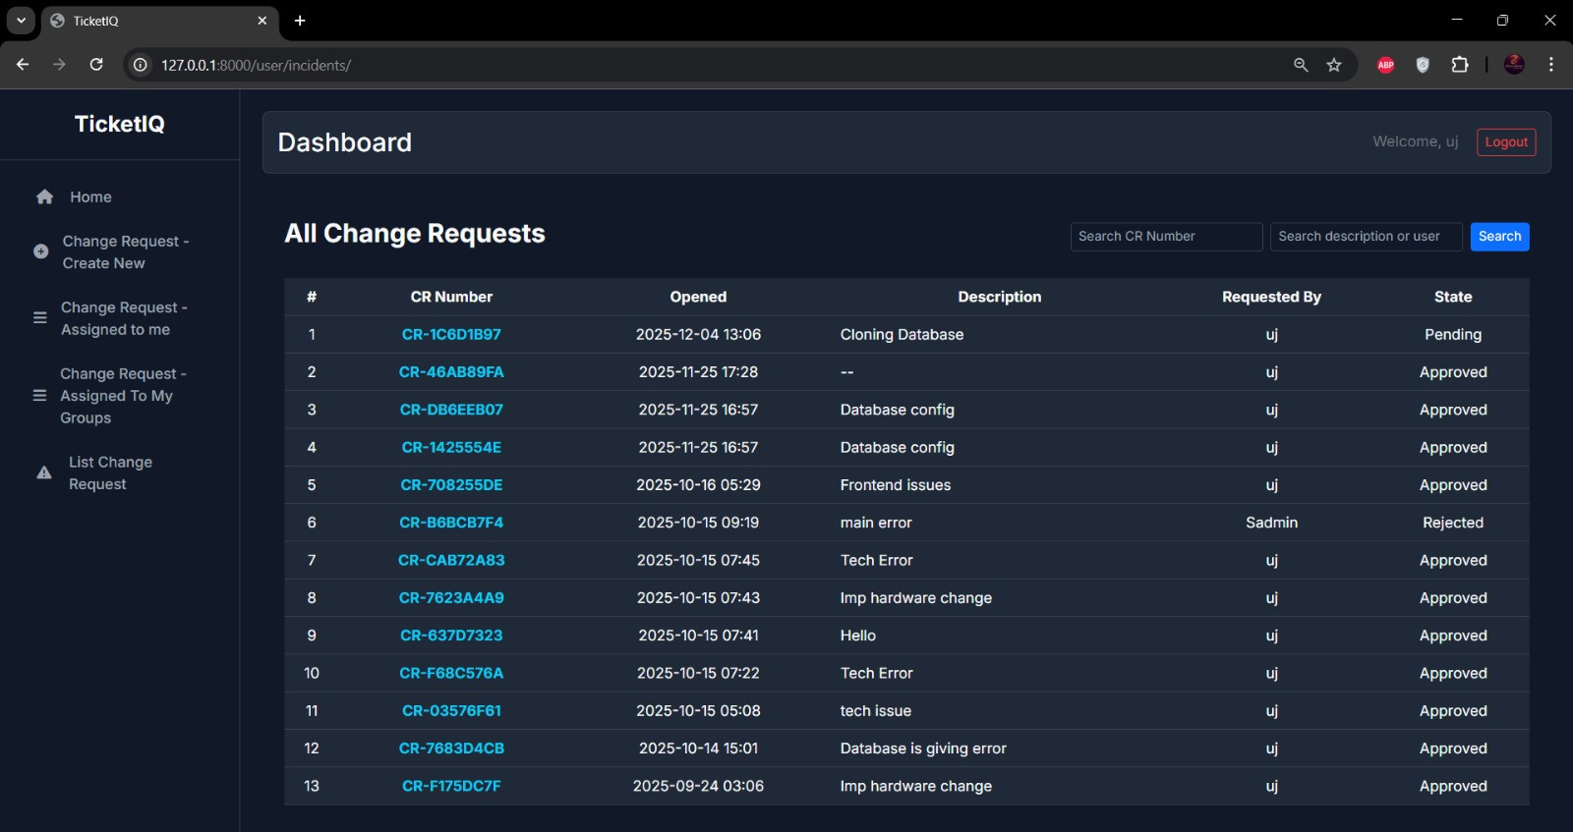
All Change Requests Page

Slide 32
Web Page Layout
Super Admin Panel

Slide 33
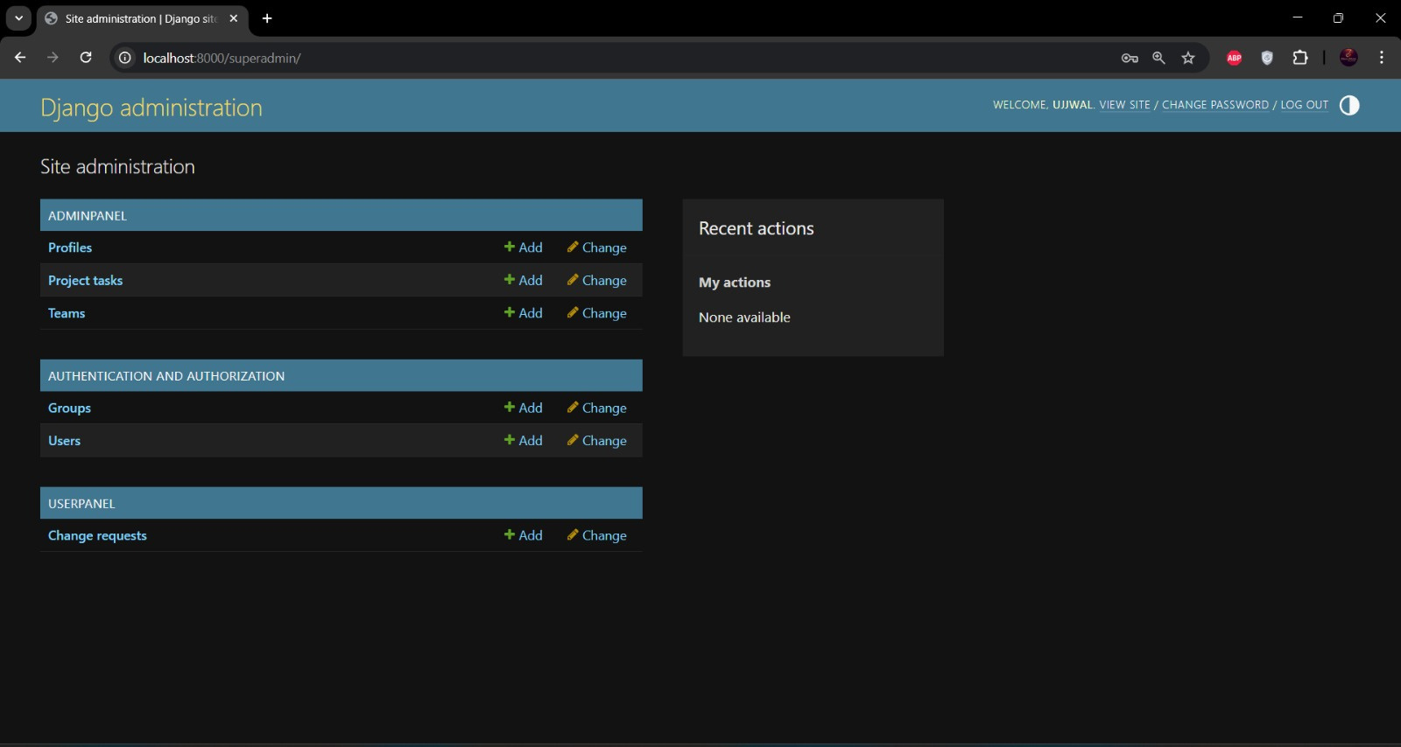

Slide 34
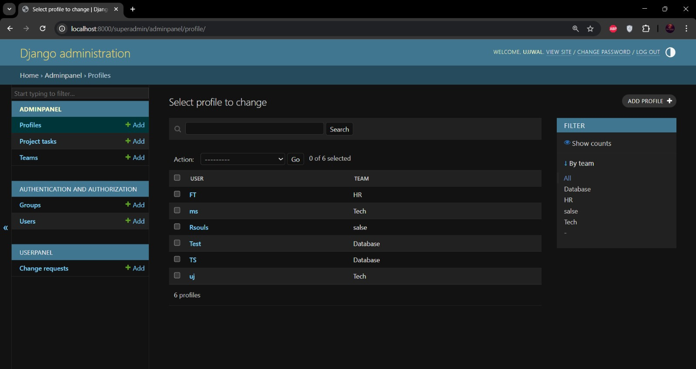

Slide 35
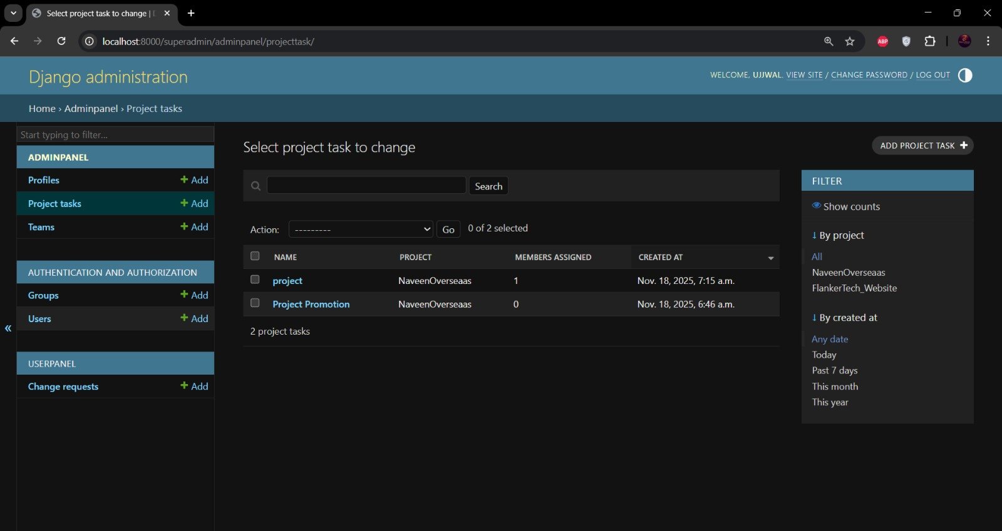

Slide 36
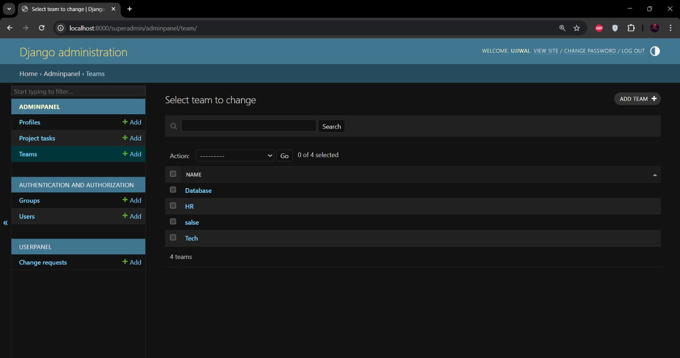

Slide 37
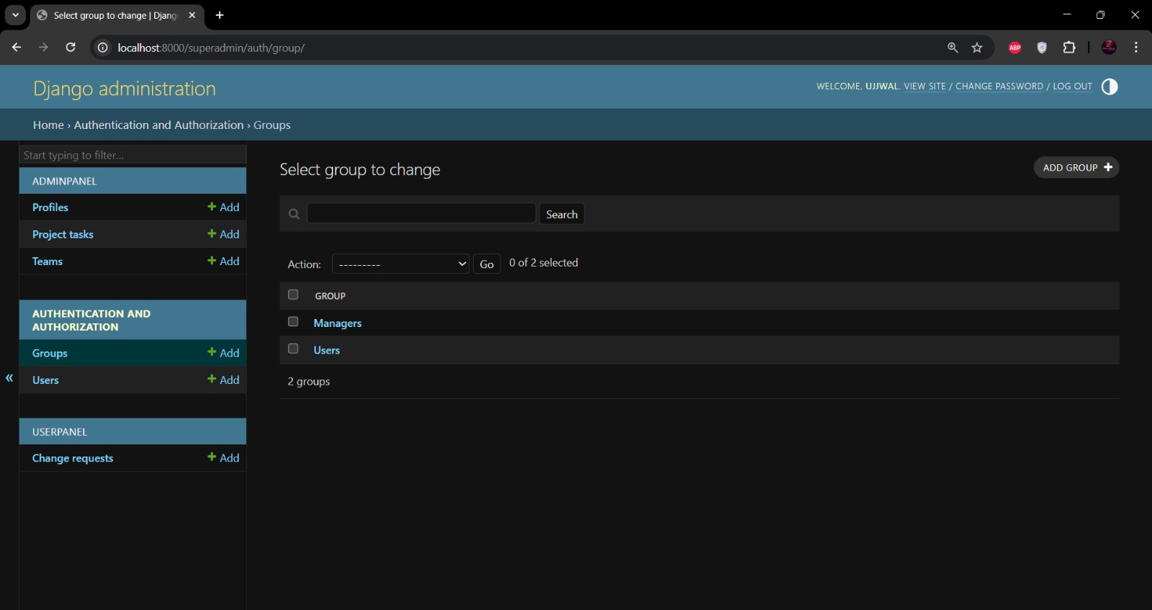

Slide 38
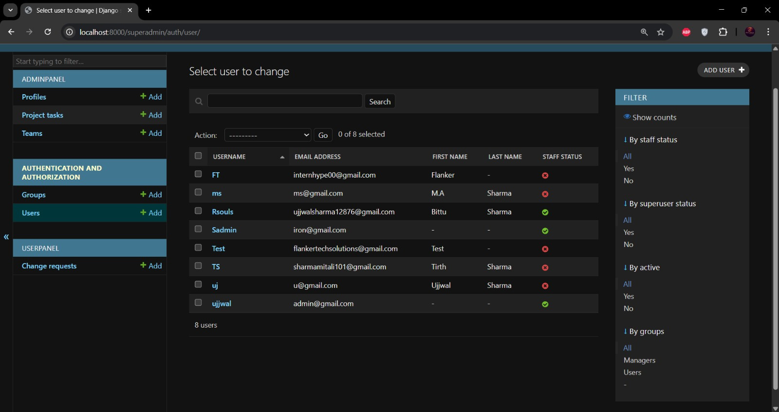

Slide 39
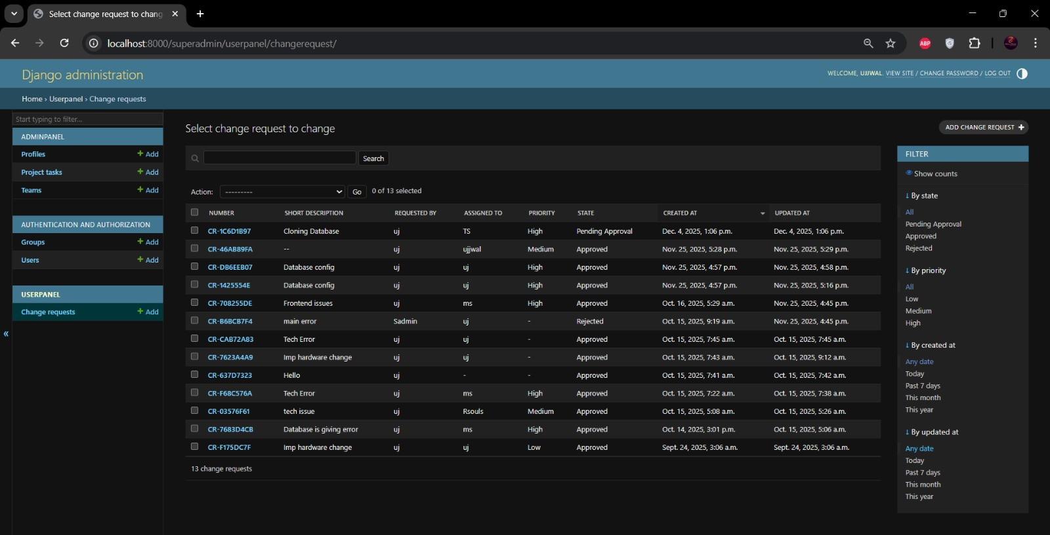

Slide 40
Web Page Layout
MySQL Database Tables

Slide 41
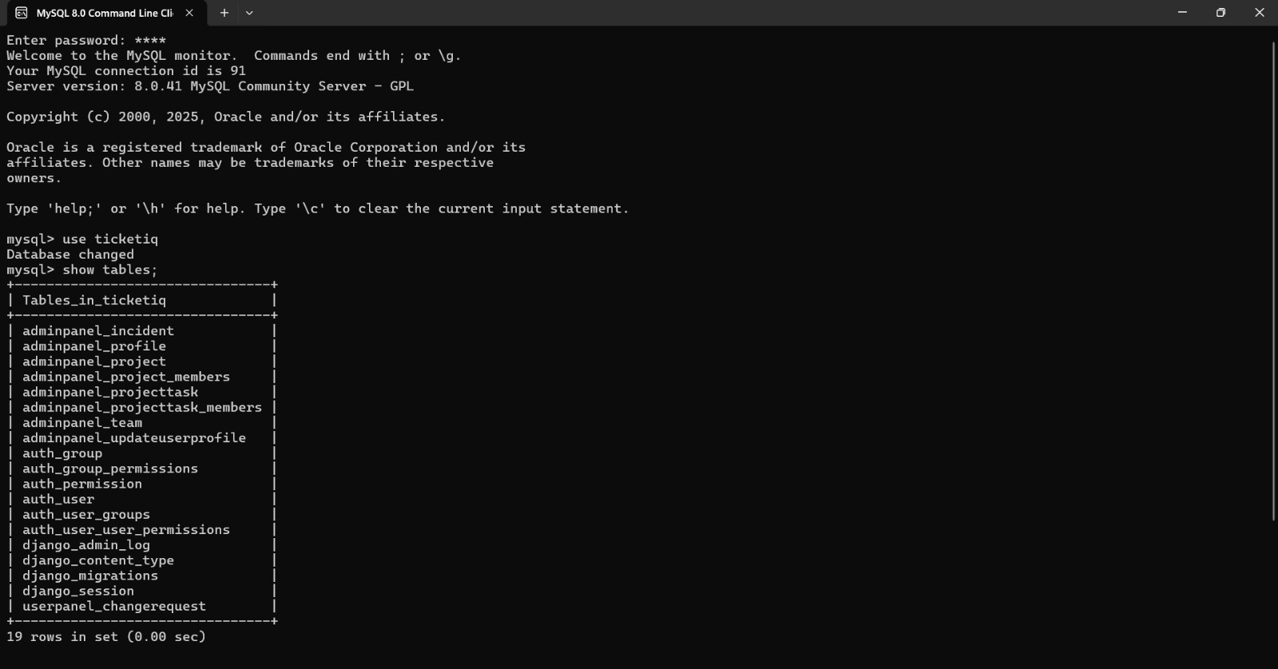

Slide 42
Conclusion
The TicketIQ project has successfully evolved into a functional prototype, resolving the challenge of decentralized IT support. By implementing Role-Based Access Control, a formal approval workflow, and a professional interface, we have established a clear and accountable system.
Key outcomes include:
Structured Operations: Transforming ad-hoc requests into tracked Incidents.
Technical Growth: Overcoming backend synchronization challenges to master Django migrations.
Future Readiness: A solid foundation prepared for enhancements like email automation.

Slide 43
References
Backend Technologies :
- Python : https://www.python.org/
- Django Framework : https://www.djangoproject.com/
- MySQL : https://www.mysql.com/
Frontend Technologies :
- HTML5 and CSS3
- Bootstrap5 : https://getbootstrap.com/
- Chart.js : https://www.chartjs.org/
Design and Assets :
- Font Awesome : https://fontawesome.com/
- Google Fonts (Inter) : https://fonts.google.com/specimen/Inter
- Unsplash : https://unsplash.com/
- SB Admin 2 Template : https://startbootstrap.com/theme/sb-admin-2

